Slide 1
Deploy at scale with Docker, CoreOS, Kubernetes and Apache Stratos
Last Updated: October. 2014
Notes:
Platform-as-a-Service (PaaS) streamlines DevOps and allows developers to focus on application development. The PaaS handles provisioning, scaling, high availability, and tenancy.
Integration with the Docker platform, CoreOS Linux distribution, and Kubernetes container management system bring more scalability and flexibility to a PaaS. This session will include installing and deploying sample applications using Docker,CoreOS and Kubernetes, and a walkthrough on how it can be extended to support new application containers. It will also include a demonstration of app deployment, provisioning, auto-scaling, and more

Slide 2

About the Presenter
Chris Haddad
SaaS Pioneer
Helps drive Platform as a Service strategy at WSO2
F500/G2000 Advisor
Open Source Aficionado
Learn more about me
Follow me @cobiacomm on Twitter
Blog: http://blog.cobia.net/cobiacomm
Decks: http://www.slideshare.net/cobiacomm/
Profle: http://www.linkedin.com/in/cobiacomm/
On Google+ too

Slide 3
Agenda
Presentation
Motivation
Cloud Scale Architecture
Moving Parts
Real world Application Composition Scenarios
Running at Scale
Container as a Service Platform Demo
Launch kubernetes cluster + CoreOS nodes
Launch event backplane and load balancer
Launch Platform as a Service components
Deploy Application Model Policies
Launch dockerized application
Test and Scale <- Iterate
*

Slide 4

Notes:
Cloud Business Value For Development Teams
Lower development barriers
Lower adoption barriers
Build Impossible Solutions

Slide 5
First Order Dev Concerns
Can I forklift my existing app into the Cloud?
Can I find room for my app in the Cloud?
How easily can I deploy my complex app in the Cloud?
What about a micro-service design approach?
*

Slide 6
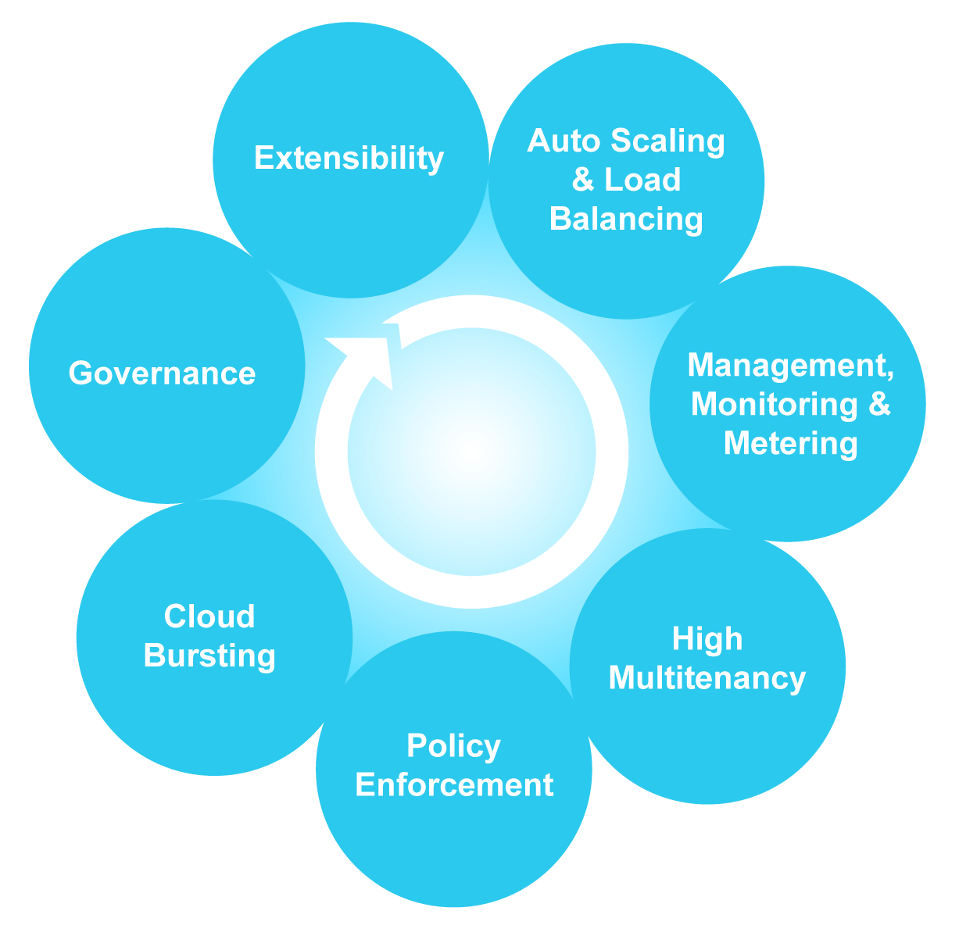
Ops-centric Concerns

Slide 7
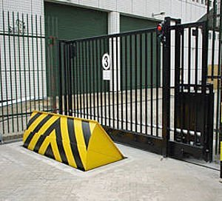
Do you hit Gates and Roadblocks?
Solution Fragility
Operational Burdens
Developer Productivity
Image Source: http://blog.industryweapon.com/2010/01/beware-of-the-business-blocker/

Slide 8
Solution: Cloud-Native Platform
Automate Deployment
Dynamically Deliver Service Management
Facilitate Root Cause Analysis
*

Slide 9
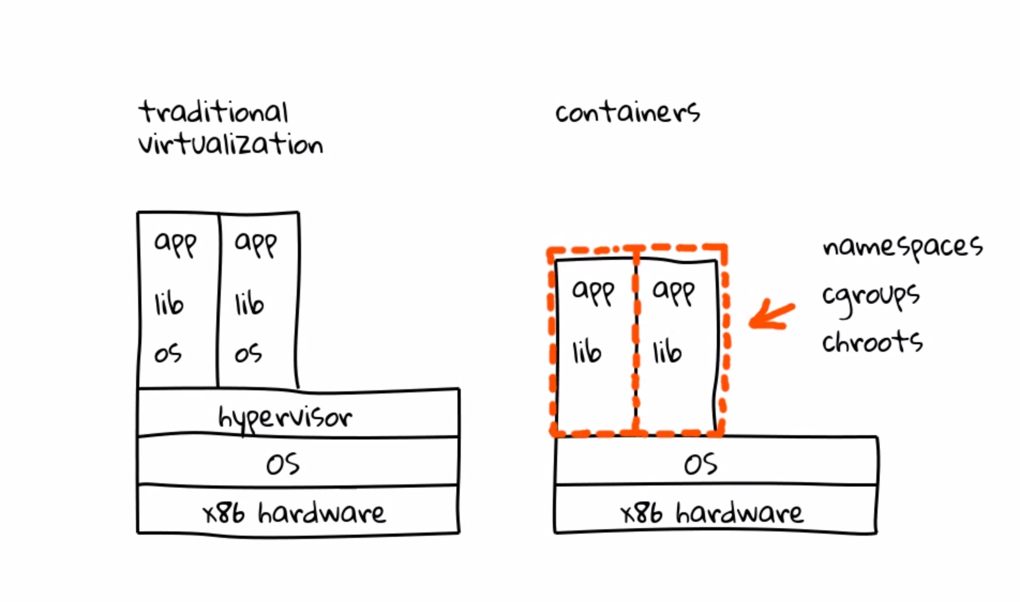
Changing the Deployment Paradigm
*

Slide 10
Container Design Goals
Composable
Security
Image distribution
Open
*
Notes:
Composable. All tools for downloading, installing, and running containers should be well integrated, but independent and composable.
Security. Isolation should be pluggable, and the crypto primitives for strong trust, image auditing and application identity should exist from day one.
Image distribution. Discovery of container images should be simple and facilitate a federated namespace, and distributed retrieval. This opens the possibility of alternative protocols, such as BitTorrent, and deployments to private environments without the requirement of a registry.
Open. The format and runtime should be well-specified and developed by a community. We want independent implementations of tools to be able to run the same container consistently

Slide 11
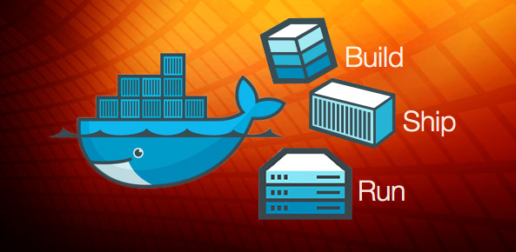
What is Docker?
A platform create, run, and manage portable containers
Container image
Only the bits necessary to run application within container space
Container run-time
Environment parameters, software defined networking, provisioning scripts
Container discovery
Find and download a container image
*
Notes:
App Container Image: definition of a signed/encrypted tgz that includes all the bits to run an app container.
App Container Runtime: definition of the environment the running app container should be given.
App Container Discovery: a federated protocol for finding and downloading an app container image.

Slide 12
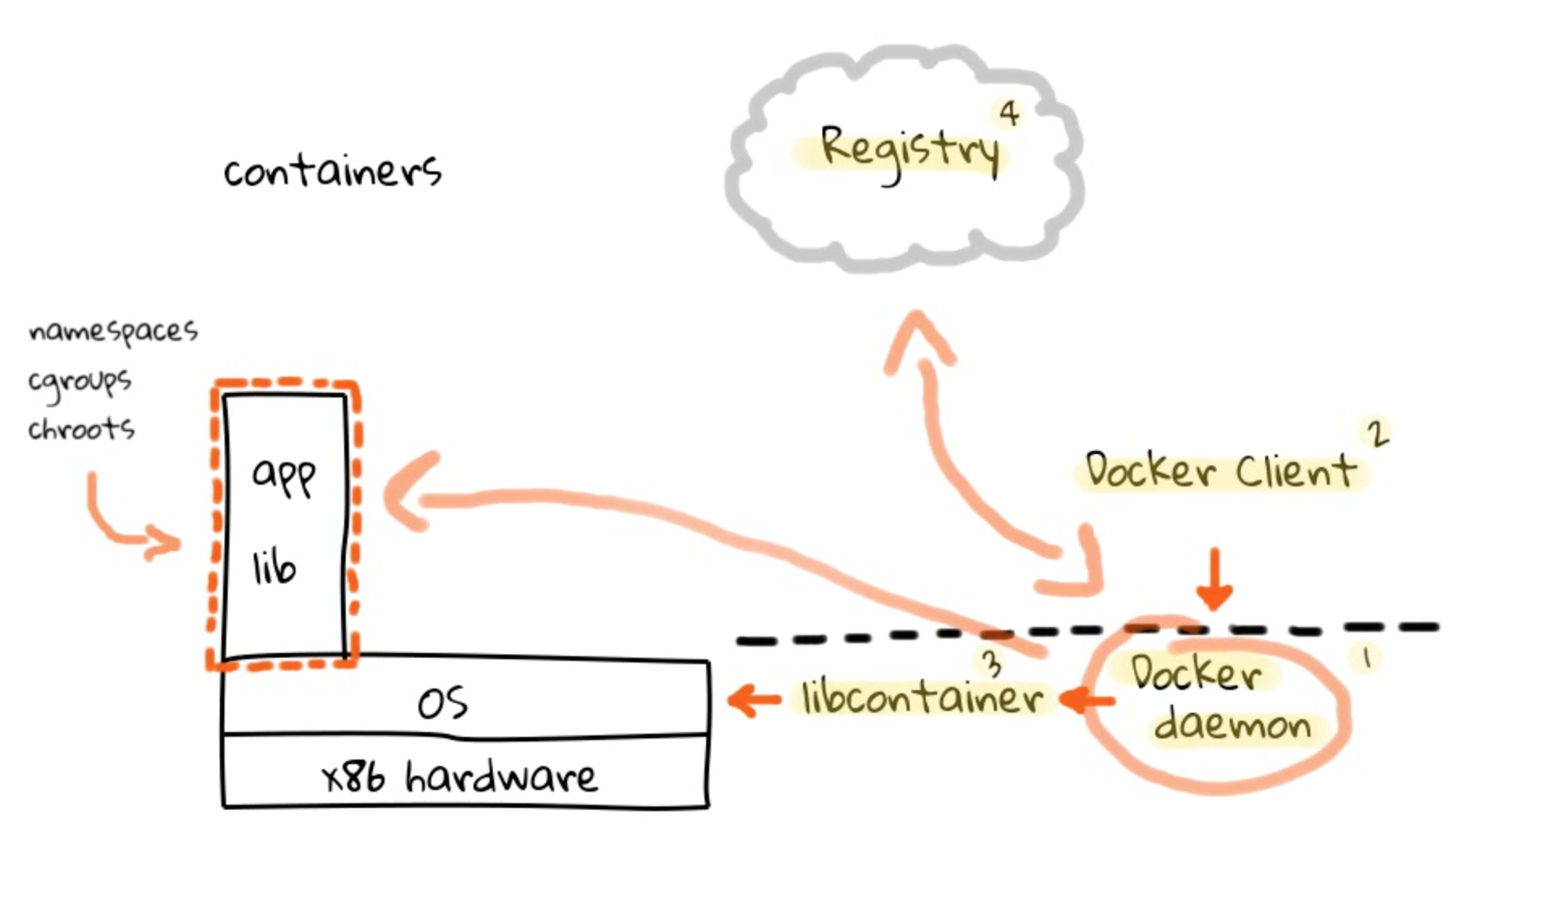
Visualizing Docker @ runtime
*

Slide 13
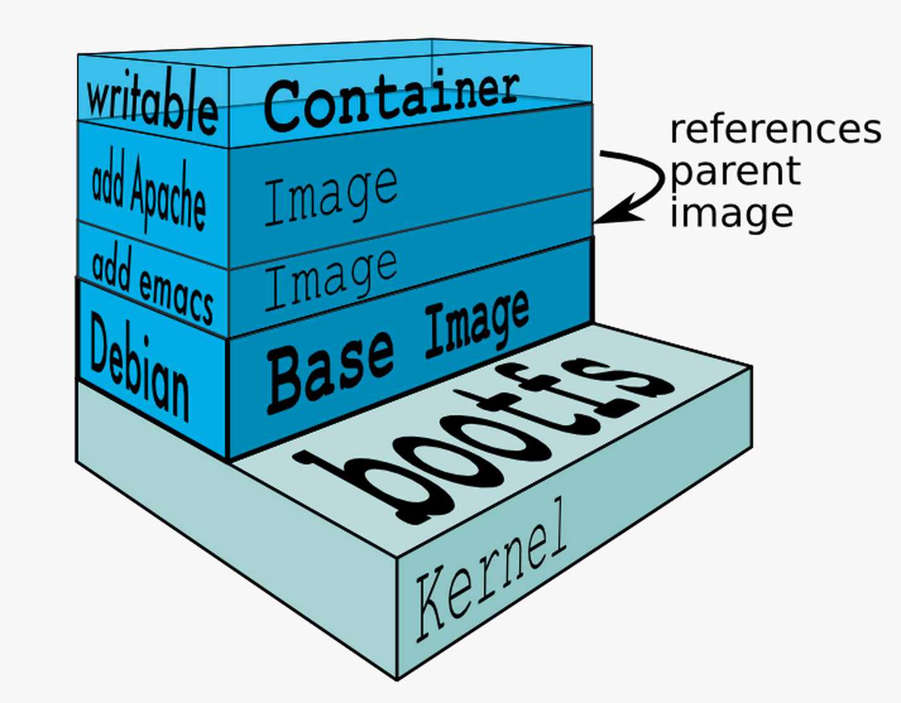
Docker Streamlines Image Management
*
Notes:
Docker Layers Capabilities and Snapshots Environment
Provision and re-provision with providers

Slide 14
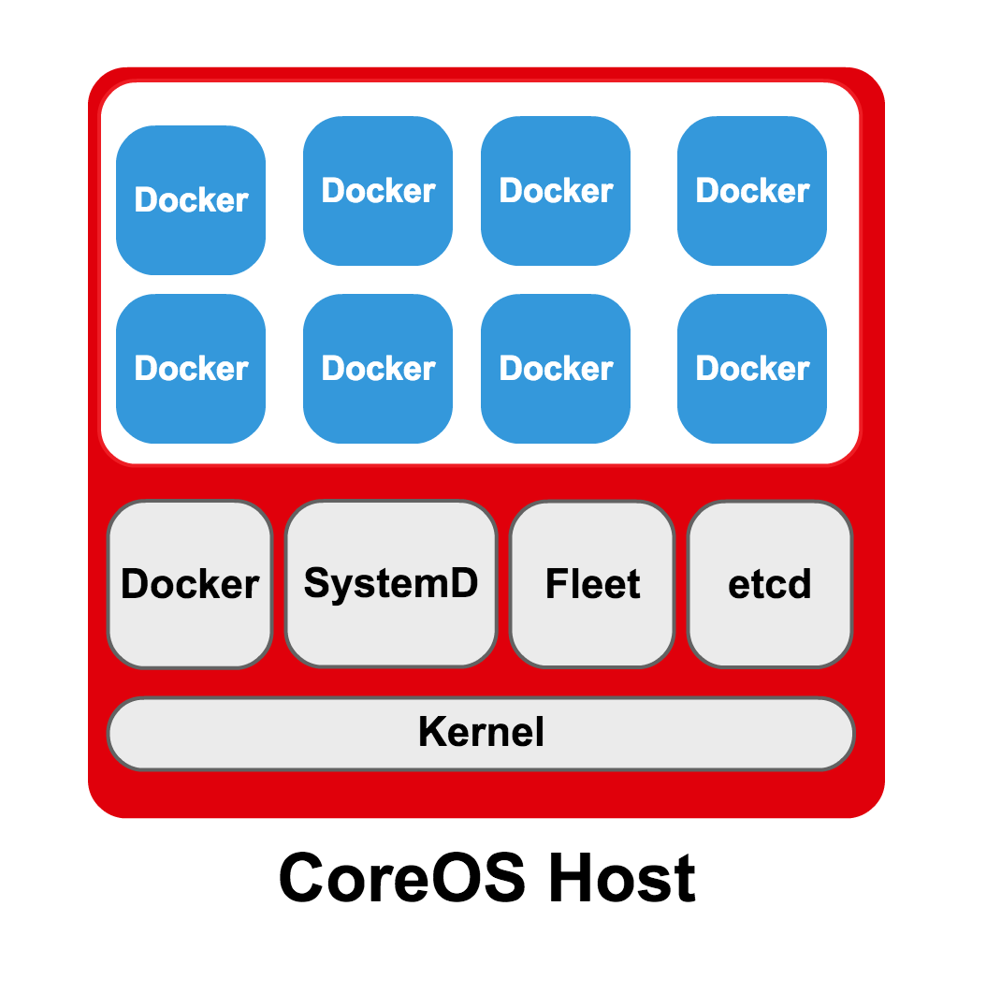
What is CoreOS?
Systemd – container bootstrapping
Fleet – container scheduling
Etcd – discovering configuration values
Flannel – overlay a software defined network fabric
*
Notes:
Fleet – container scheduling
Systemd – container bootstrapping
Etcd – discovering configuration values
Flannel – overlay a software defined network fabric
flannel - https://github.com/coreos/flannel
flannel is an etcd backed network fabric for containers
Fleetd - https://github.com/coreos/fleet
A Distributed init System
Fleet presents the cluster as a distributed init system by aggregating systemd running on each machine. Units are submitted into fleet and the units scheduled onto machines in the cluster based on fleet-specific configuration parameters encoded in the unit file.
Systemd
CoreOS uses systemd as the core of its distributed init system, fleet. Systemd is well supported in many Linux distros, making it familiar to most engineers. Every aspect of CoreOS is deeply integrated with systemd.
Systemd boots extremely fast, with our goal to keep it under 1s.
Systemd has an extremely rich syntax that can describe the attributes of a particular service. Your services can express hard or soft dependencies, the order of launch relative to those dependencies, and identify conflicting services. Docker containers are much easier to manage when you can specify whether they automatically restart per container and customize the timing for restarting.

Slide 15
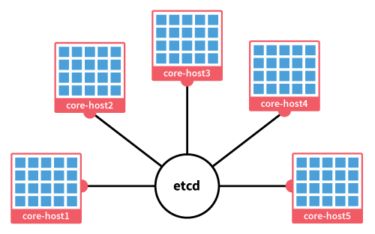
Scale Out with CoreOS Clustering and etcd
*

Slide 16
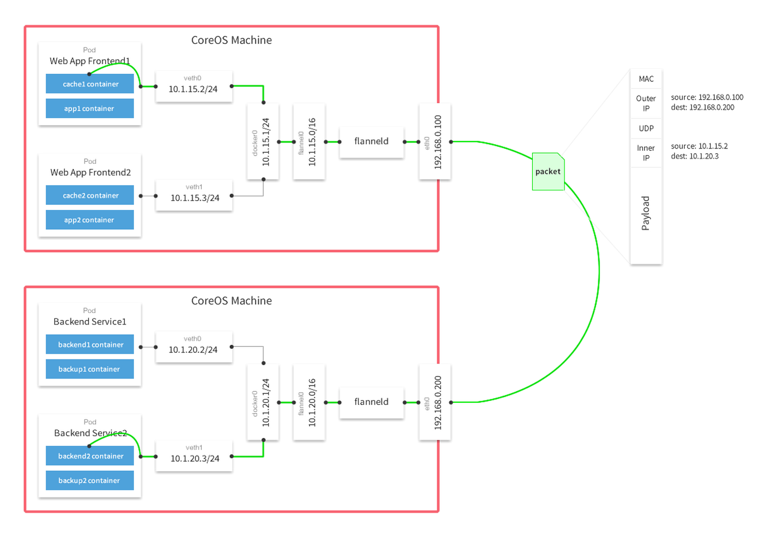
Flannel in Action
*

Slide 17
Why add Kubernetes?
Manage clusters and containers
Schedule
Control
Concepts
Pods
Labels
Nodes
*
Notes:
https://github.com/GoogleCloudPlatform/kubernetes/blob/master/DESIGN.md
Kubernetes – https://github.com/coreos/kubernetes
Container Cluster Manager
https://github.com/GoogleCloudPlatform/kubernetes/blob/master/DESIGN.md
Kubernetes is a system for managing containerized applications across multiple hosts, providing basic mechanisms for deployment, maintenance, and scaling of applications. Its APIs are intended to serve as the foundation for an open ecosystem of tools, automation systems, and higher-level API layers.
Kubernetes uses Docker to package, instantiate, and run containerized applications.
Is Kubernetes, then, a Docker "orchestration" system? Yes and no.
Kubernetes establishes robust declarative primitives for maintaining the desired state requested by the user. We see these primitives as the main value added by Kubernetes. Self-healing mechanisms, such as auto-restarting, re-scheduling, and replicating containers require active controllers, not just imperative orchestration.
Kubernetes is primarily targeted at applications comprised of multiple containers, such as elastic, distributed micro-services. It is also designed to facilitate migration of non-containerized application stacks to Kubernetes. It therefore includes abstractions for grouping containers in both loosely coupled and tightly coupled formations, and provides ways for containers to find and communicate with each other in relatively familiar ways.
While Docker itself works with individual containers, Kubernetes provides higher-level organizational constructs to support common cluster-level usage patterns, currently focused on service applications. Some of the important constructs/concepts are described below.
- POD: Relatively tightly coupled group of containers that are scheduled onto the same physical node. Containers in a POD all use the same network namespace/IP (and port space) and defines a set of shared storage volumes. They serve as a unit of scheduling, deployment and replication.
- LABELS: Loosely coupled cooperating pods are organized using key/value labels. Each POD can have a set of key/value set on it.
- KUBERNETES NODE: It is a physical node that has services necessary to run Docker containers and be managed from master systems

Slide 18
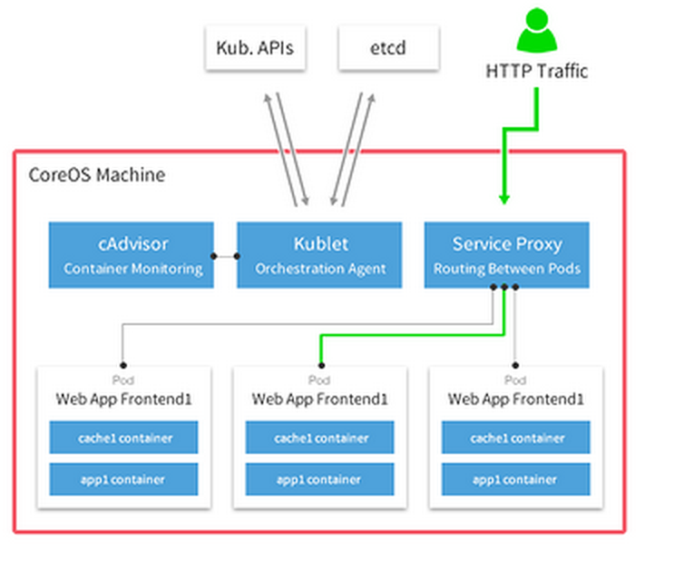
Kubernetes with CoreOS
*

Slide 19
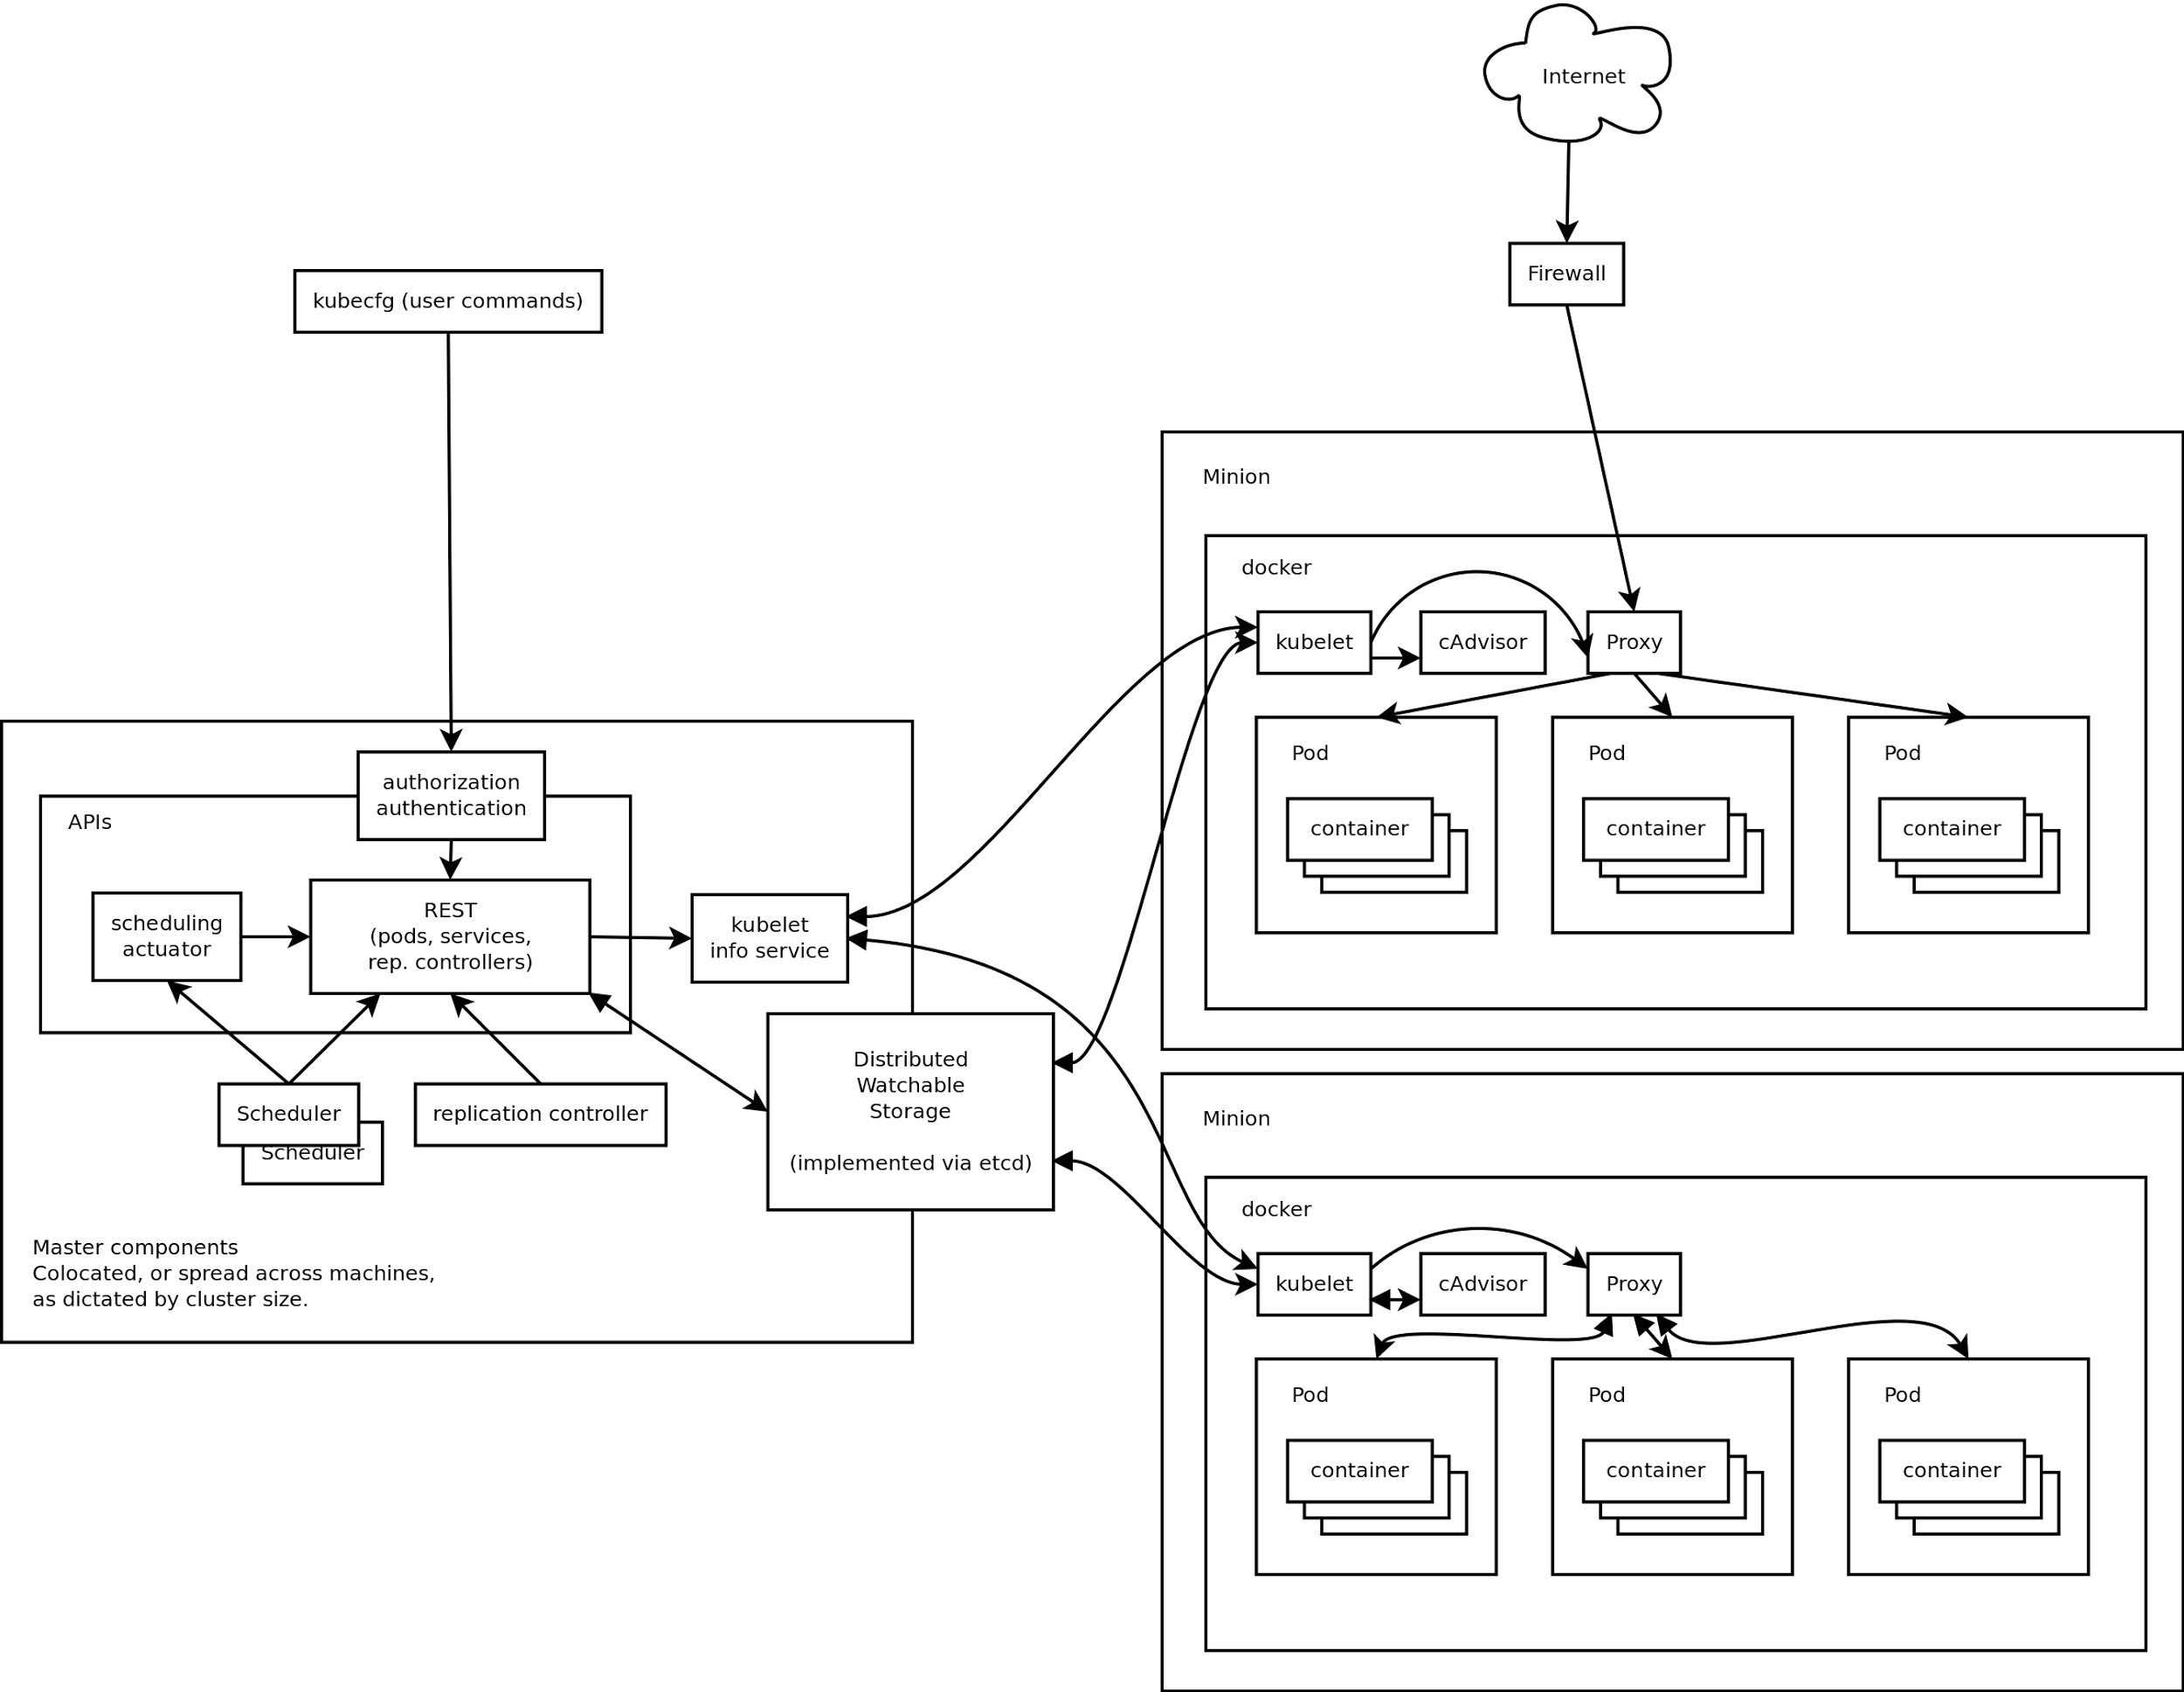
Kubernetes in Action
*
Source: https://github.com/GoogleCloudPlatform/kubernetes/blob/master/DESIGN.md
Notes:
Source: https://github.com/GoogleCloudPlatform/kubernetes/blob/master/DESIGN.md
http://www.symantec.com/connect/blogs/google-kubernetes-analytical-evaluation

Slide 20
Kubernetes – Opportunity Zone
“we want Kubernetes to be built as a collection of pluggable components and layers, with the ability to use alternative schedulers, storage systems, and distribution mechanisms, and we're evolving its current code in that direction.”
“A single Kubernetes cluster is not intended to span multiple availability zones. Instead, we recommend building a higher-level layer to replicate complete deployments of highly available applications across multiple zones.”
Source: https://github.com/GoogleCloudPlatform/kubernetes/blob/master/DESIGN.md
*
Notes:
Source: https://github.com/GoogleCloudPlatform/kubernetes/blob/master/DESIGN.md
http://www.symantec.com/connect/blogs/google-kubernetes-analytical-evaluation

Slide 21
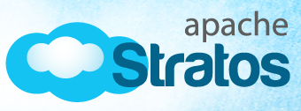
The Role of Apache Stratos
Package Manager
Define Security and Network Policies
Manage Micro-service Definition
Define Composite Application
Container Auto-Scaler Logic
Manage Service Subscriptions
*
Notes:
Package Manager [container images]
Define Security and Network Policies [coreOs configuration for etc, systemd, flannel]
Manage Micro-service Definition [kubernetes labels]
Define Composite Application [kubernetes pods – tightliy coupled, kubernetes ?]
Container Auto-Scaler Logic [plug in controller to kubernetes]
Manage Service Subscriptions [tenant registration]

Slide 22
Apache Stratos 4.1 – Containerization and Composition Release
Application Composition
Containerization
Docker based cartridge support
integration with CoreOS
integration with Kubernetes
integration with flannel
integration with discovery service and build in docker registry support
Support docker top of VM
provide two level of scalability
support for integrated with any existing IaaS
any public, private cloud support which can run docker host VM
*

Slide 23
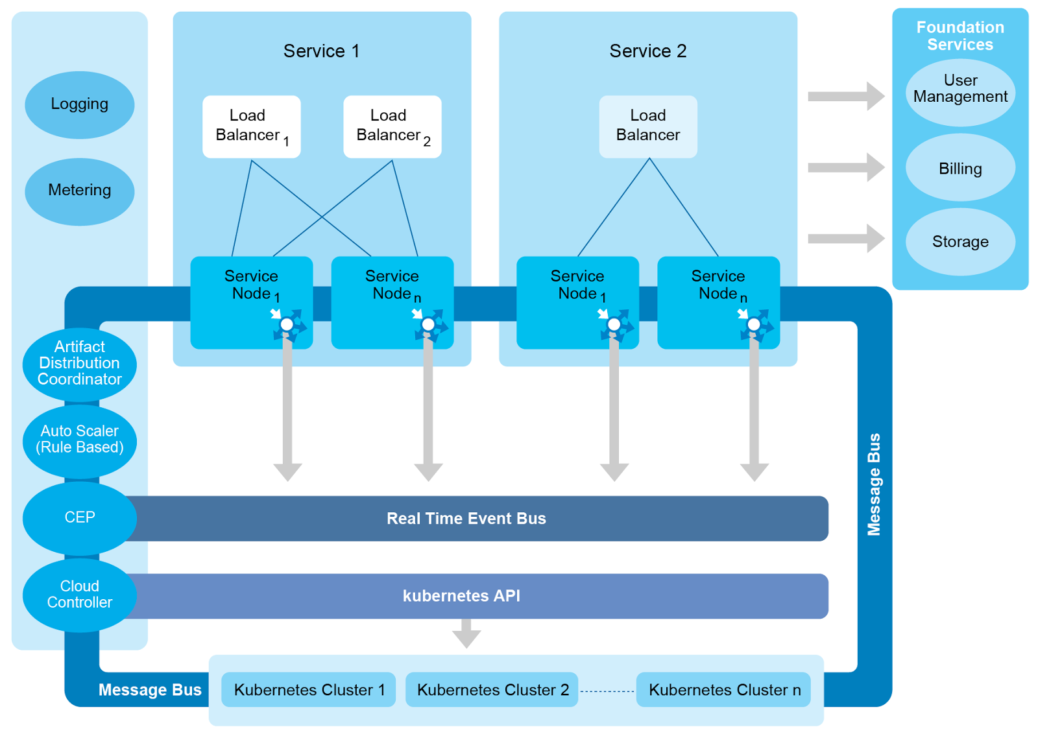
Apache Stratos L1 Deployment Architecture for Docker based Cartridges
*

Slide 24
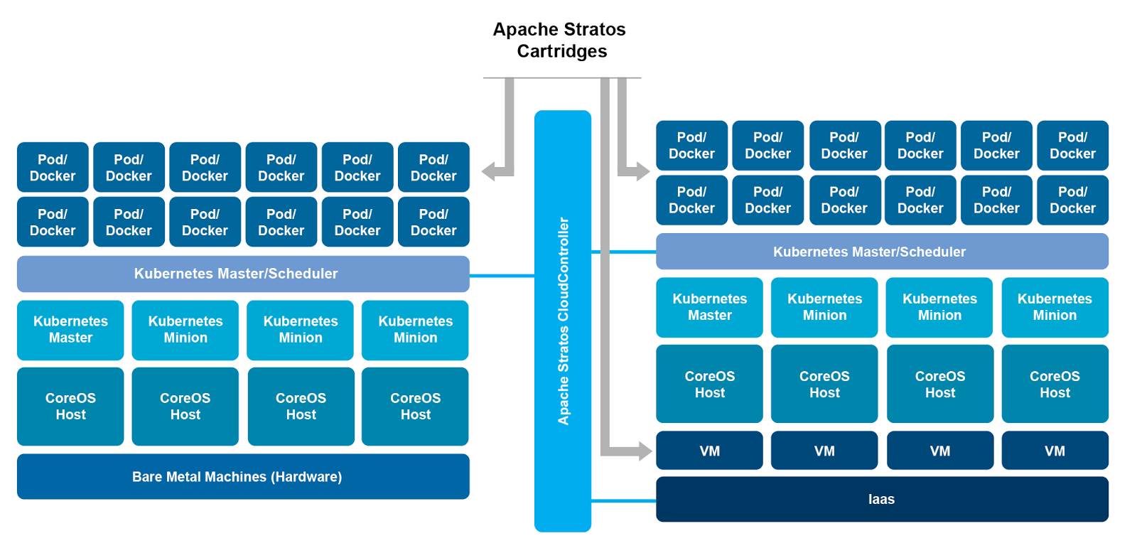
Stratos Architecture with Docker Support
*

Slide 25
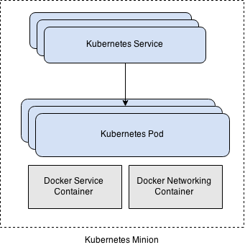
Kubernetes Resources Used by Stratos
A Kubernetes Service is created for each transport/port mapping defined in the cartridge.
Kubernetes Service is a load balancing service for Pods.
A Kubernetes Pod is created for each member in a cluster.
A Kubernetes Pod is a group of Docker containers.
Kubernetes creates a separate Docker container for networking.

Slide 26
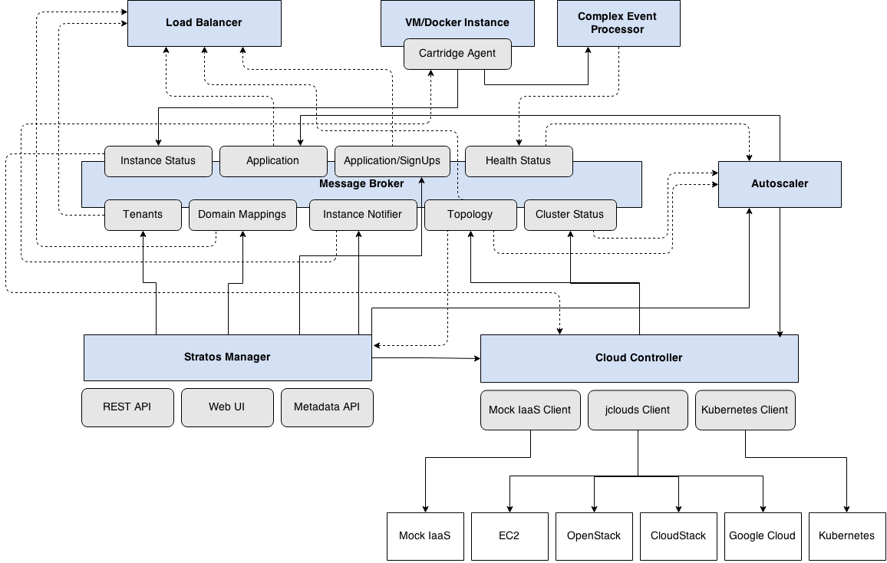
Stratos Architecture

Slide 27
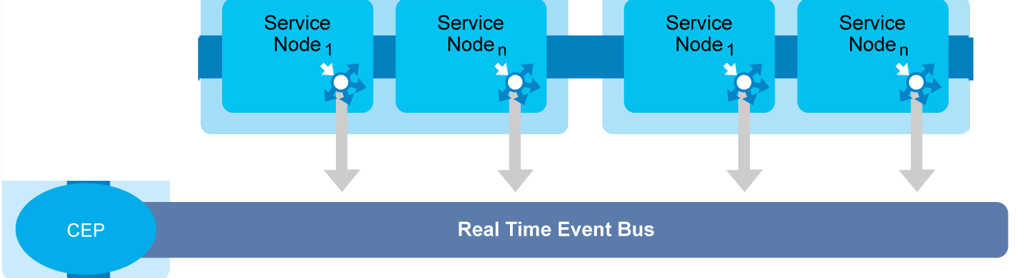
Stratos Differentiator: Real Time Event Bus
Notes:
What details are?
Instance up/down time
Each and every instances health status
- application health, load average, memory
consumption
Application logs
Why should one care?
Centralize view for all logging, metering and monitoring
What are the advantages?
DevOps life easy
- centralize log viewer
- centralize dashboard
Easy to throttling

Slide 28
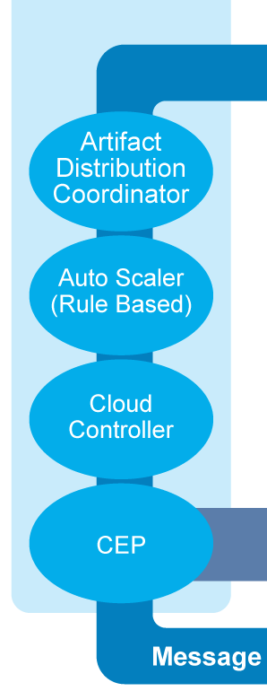

Stratos Differentiator: Cloud Controller

Slide 29
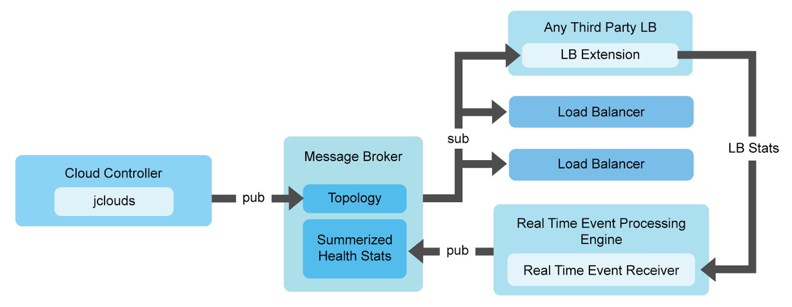
Scalable and Dynamic Load Balancing..
*
Notes:
How Scalable it is?
In theory infinite
- horizontal scaling
- limited by resource (instance capacity) availability
How Dynamic it is?
Load Balancers are spawned dynamically
- LB too is a cartridge
In case of multi-cloud, multi-region, LB can scale per cloud/region
Per service cluster LB

Slide 30
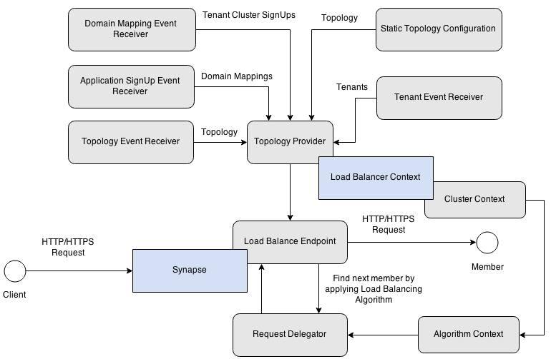
Stratos Load Balancer Architecture

Slide 31
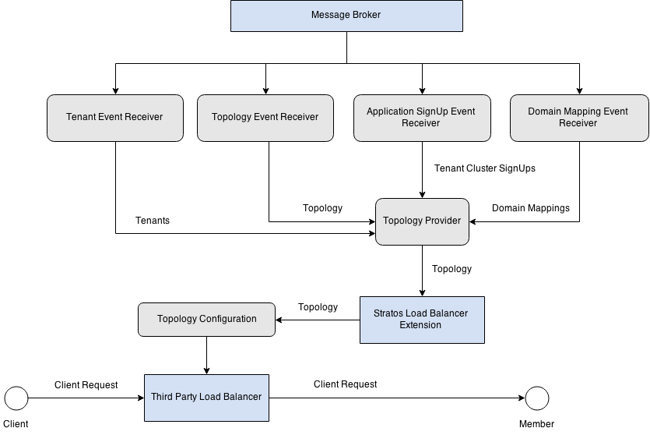
Stratos Load Balancer Extension Architecture

Slide 32
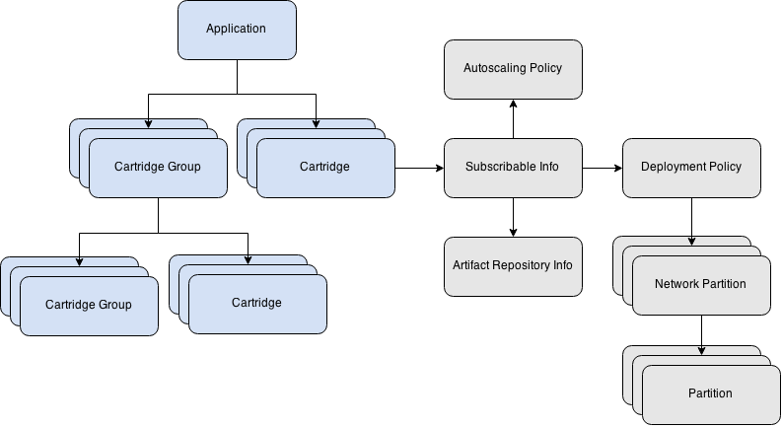
Composite Application Model and Policy Model

Slide 33
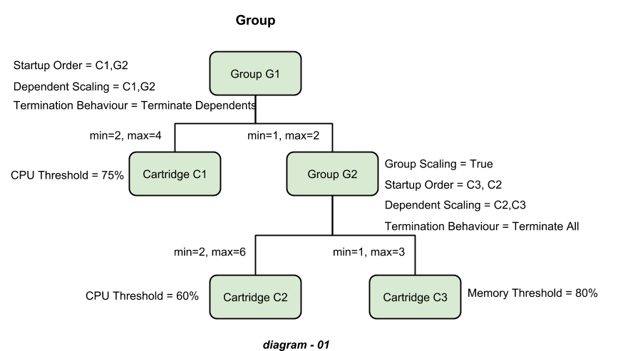
Groups = Composite Cloud Instances
*

Slide 34
Smart Policies
What are the smart policies?
Auto scaling
Deployment
Auto scaling policy
Define thresholds values pertaining scale up/down decision
Auto Scaler refer this policy
Defined by DevOps
Deployment policy
Defined how and where to spawn cartridge instances
Defined min and max instances in a selected service cluster
Defined by DevOps based on deployment patterns
*
Notes:
Why should one care?
Can provide cloud SLA
What are the advantages?
Make DevOps life easy
- help keep to SLA
Make SaaS app delivery life easy
- do not have to worry about availability in application
layer

Slide 35
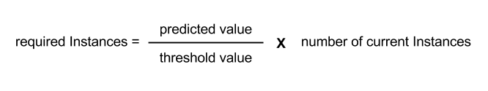
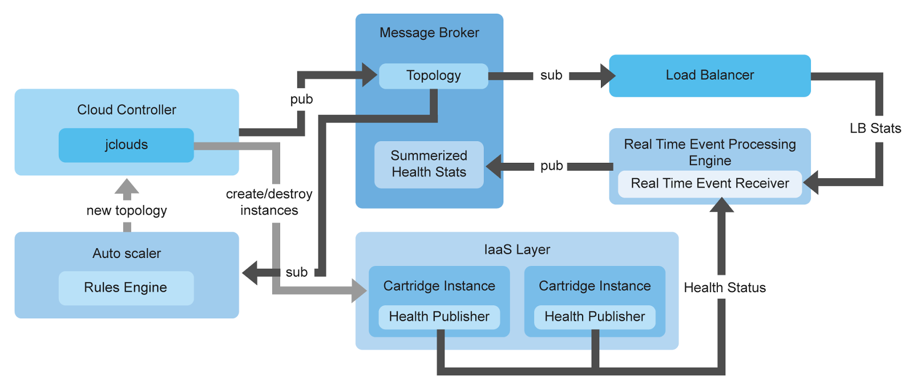
How do you specify elastic scale?
Scaling algorithm can use multiple factors. such as
- Load average of the instance
- Memory consumption of the instance
- In-flight request count in LB
*
Notes:
Capable of predicting future load
- Real time analysis of current load status using CEP
integration
- Predict immediate future load based on CEP
resulting streams
- Predicting equation s=ut + ½ at²
- s=predicted load, u=first derivative of current
average load, t= time interval , a=second derivative
of current load
Why should one care?
Maximise resource utilization
Easy to do capacity planning
Dynamic load based resource provisioning
Optimizing across multiple clouds

Slide 36
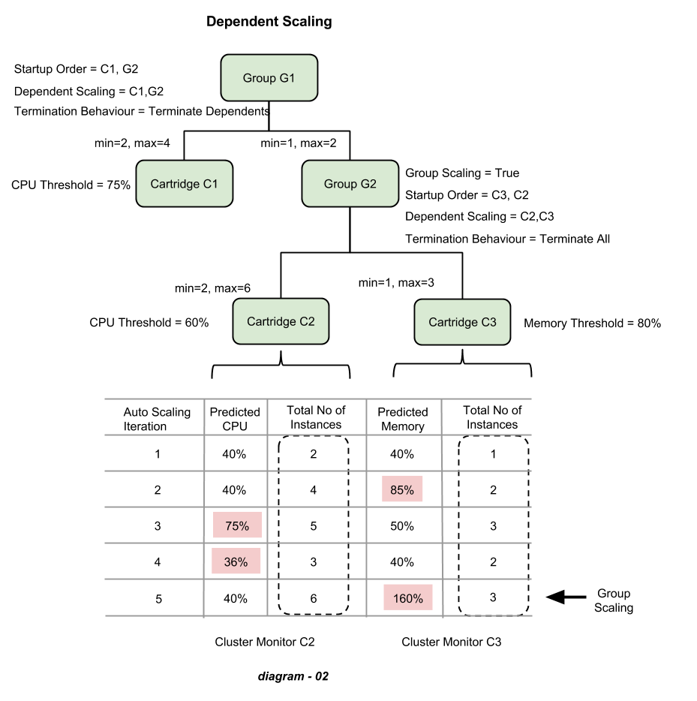
Dependent Scaling Scenario
*

Slide 37
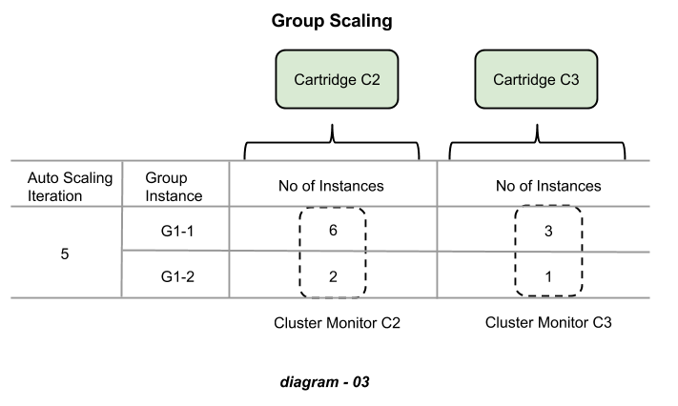
Group Scaling Scenario
*

Slide 38
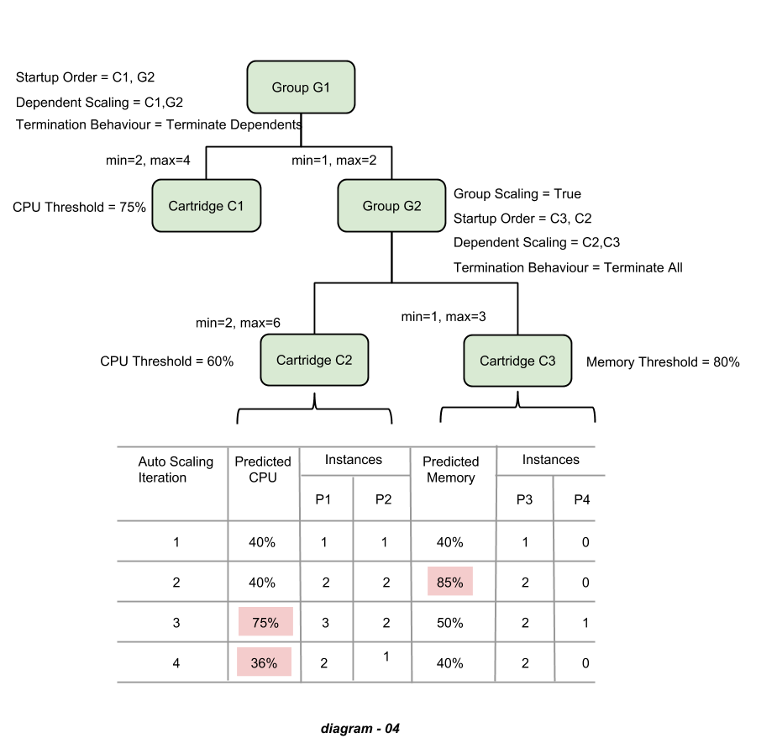
Predictive Scaling
*

Slide 39
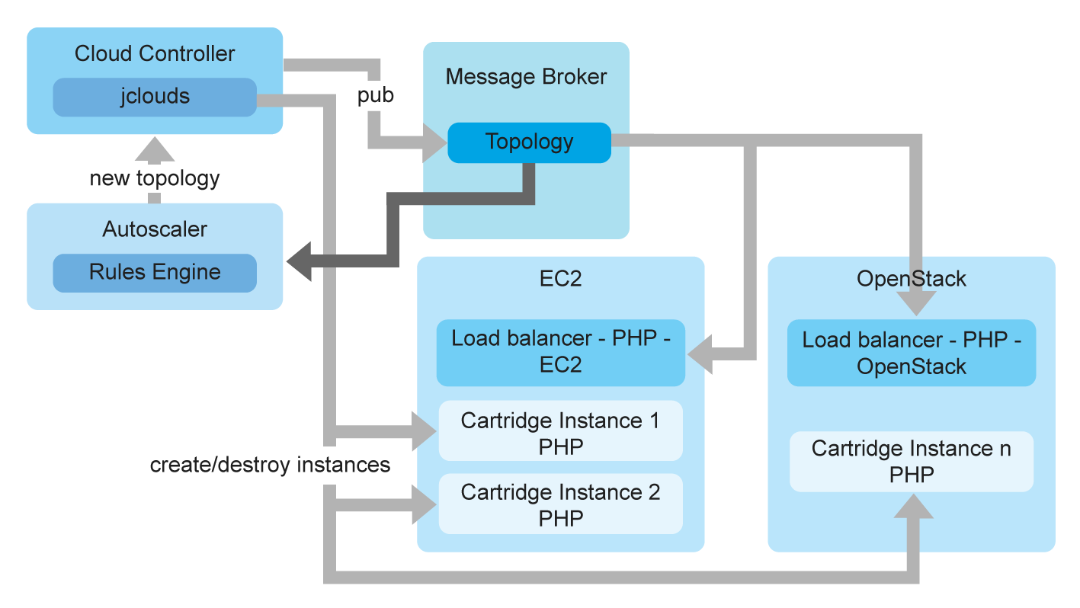
Ever try to Cloud Burst Containers?
Burst based on policy and load
*
Notes:
What is it?
Expanding/provisioning application into another cloud to handle peak load.
Why Should one care?
Resource peak time can be off-loaded to third party clouds/resources
What is unique about it?
Can off-load to any cloud
- Private, Public and Hybrid
Easy to managed with the model of LB per busting cloud

Slide 40
Demo Time
Container as a Service
Setup CoreOS cluster, Discovery service, network service, Kubernetes master and minions
Launch event backplane and load balancer
Launch Platform as a Service components
Register Kubernetes-CoreOS host cluster to Stratos
Launch dockerized application
Deploy Application Model Policies
Deploy Docker based PHP Cartridge
Deploy PHP application using PHP Cartridge
Test and Scale <- Iterate
Automated artifact updates
Manual Scaling
Autoscaling based on load avarage
*
Notes:
Background on CoreOs and Kubernetes
https://github.com/GoogleCloudPlatform/kubernetes/blob/master/docs/getting-started-guides/vagrant.md
https://coreos.com/docs/running-coreos/platforms/vagrant/

Slide 41
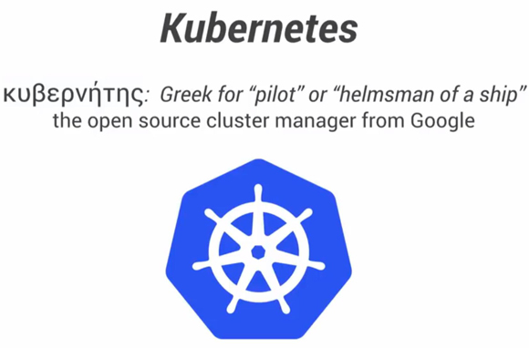
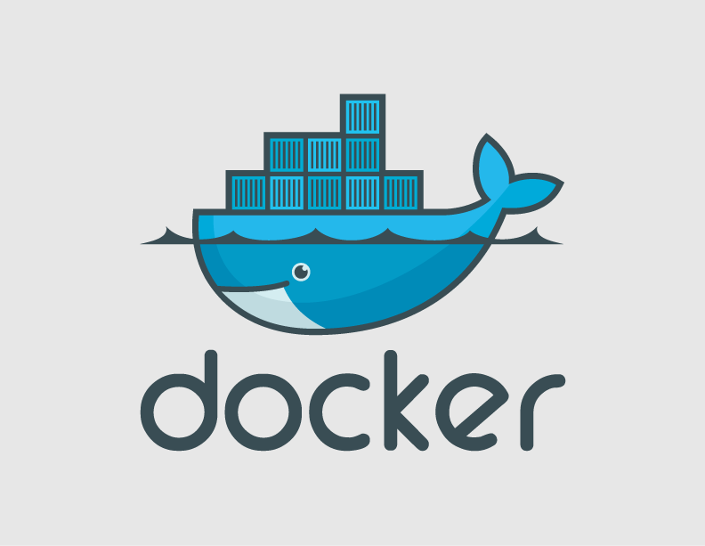
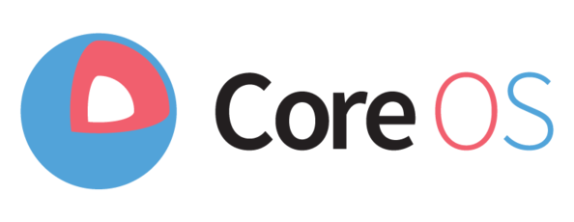
Test Drive the Cloud in a Box Distro
Download Stratos distribution, load balancer & samples:
https://dist.apache.org/repos/dist/dev/stratos/4.1.0-kubernetes-v6/
Follow Getting Started Guide: Beta Version
https://gist.github.com/imesh/b8f81fac8de39183a504

